Slide 1

MY CONTRIBUTION
A Ray of Hope Charitable Trust
One volunteer, two ways of showing up — in the classroom, and in code.
Utkarsh · Individual Volunteer & Builder

Slide 2
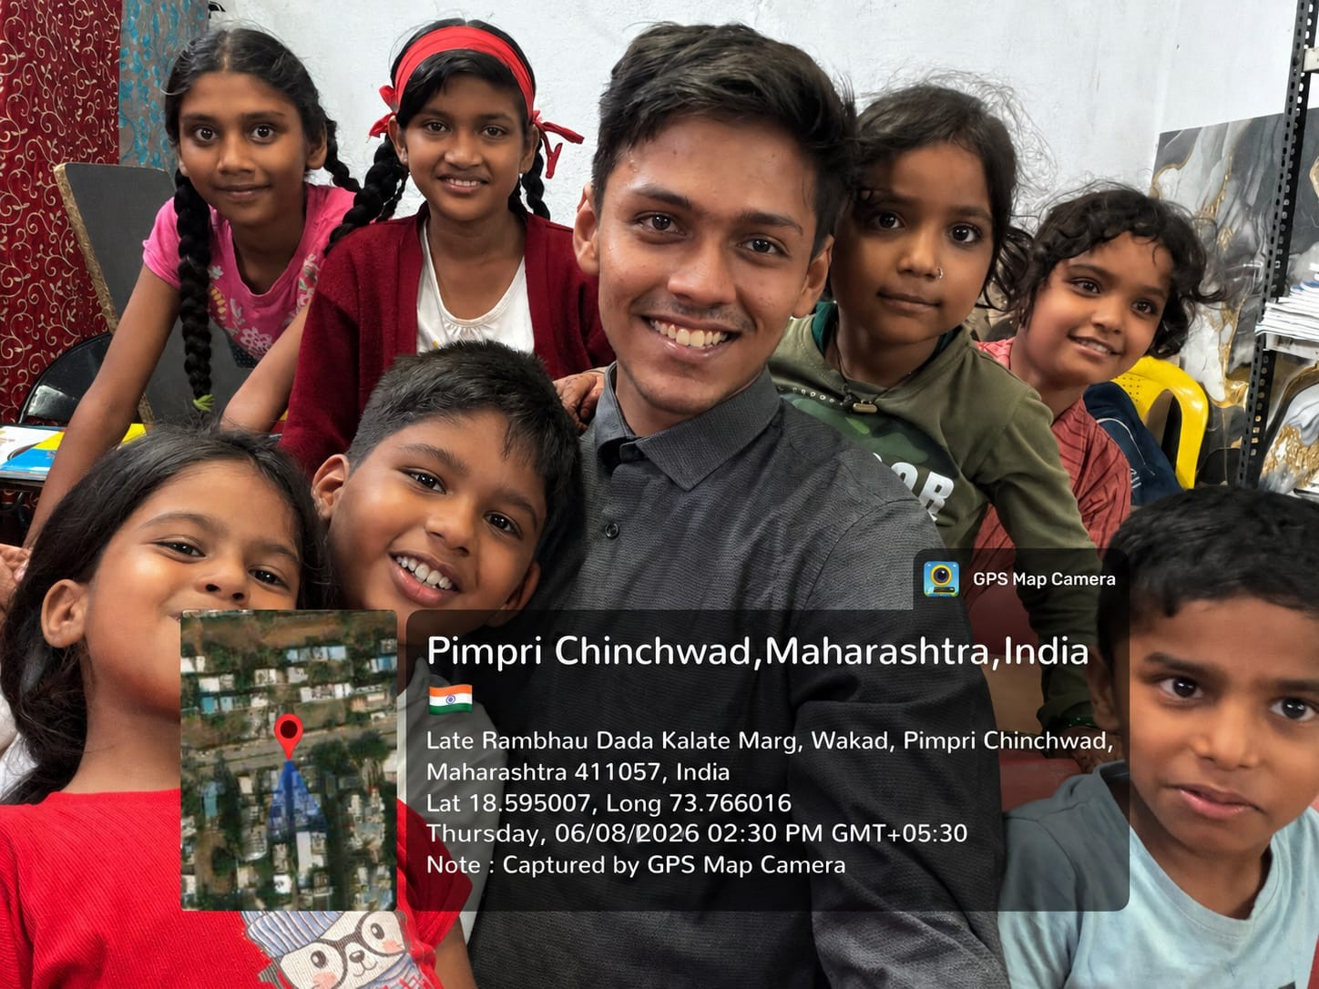
WHO I AM
AN INDIVIDUAL EFFORT,
THE SAME MISSION
1
No team, no hand-offs
Every part of this — from teaching to the tool itself — is my own work, end to end.
2
Same mission as every volunteer here
Helping children in the Trust's care get a fair shot at learning, despite limited resources at home.
3
Two ways of contributing
Hands-on teaching time each week, and a software tool that helps every volunteer's session go further.
4
Full ownership
From noticing the problem, to designing the response, to shipping a working prototype.
02

Slide 3
MY INVOLVEMENT
HOW I SHOW UP
I don't just contribute from a distance — I show up in person, and I keep coming back.
01
02
03
04
I Teach
I Mentor
I Encourage
I Return
One-on-one or in small groups, patiently, at a pace every child can keep up with.
Following up between sessions so progress doesn't stall between visits.
Celebrating every small win — a finished worksheet, a hard problem solved.
Not a one-off visit — the same face, week after week, building real trust.
03

Slide 4
MY FOCUS AREAS
WHAT I FOCUS ON
Every session mixes steady academic support with the patience to let a child learn at their own pace.
Fractions
Word Problems
Mental Math
Reading Support
Mathematics
Building number confidence, one concept at a time.
Focus & Patience
Confidence
Personalized pacing
Extra support where it's needed, more challenge where a child is ready.
Consistency
The same volunteer, every week — so children know someone is showing up for them.
Subjects & skills I work on with children each week
04

Slide 5
PROTOTYPE · ACTIVE DEVELOPMENT
MY PROJECT: SAARTHI
AI Volunteer Copilot
Volunteers here often work with limited prep time and classrooms where every child understands things a little differently. Saarthi is a tool I'm building, on my own, to turn that limited prep time into personalized lesson plans, differentiated activities, and a clear plan for the next session — so every volunteer's hour with a child counts for more.
GitHub repo
Step 1
Plan the lesson
Step 2
Teach & assess
Step 3
Recommend what's next
Same mission as the Trust: better, more personal learning support for every child — built to scale beyond just my own sessions.
05

Slide 6
SAARTHI · UNDER THE HOOD
HOW IT'S BUILT
A straightforward architecture — real APIs and a real database behind the AI layer, not a black box.
React / Next.js
Volunteer-facing frontend
FastAPI Backend
REST API layer
PostgreSQL
Student & session data
AI Services
Planner + Analyzer
FAISS
Resource retrieval (RAG)
LLM
Structured lesson generation
Student Progress & Next-Session Recos
06

Slide 7
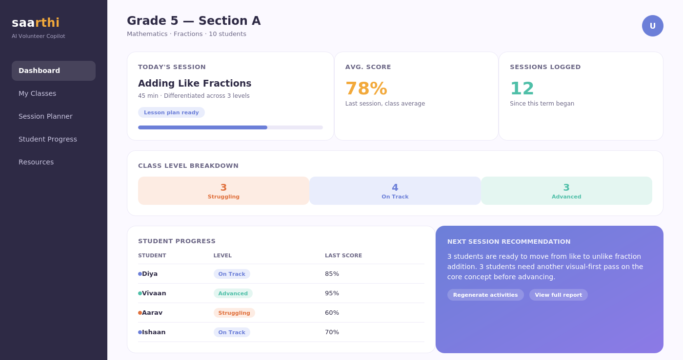
SAARTHI · PRODUCT PREVIEW
WHAT IT WILL LOOK LIKE
A mockup of the volunteer dashboard — the target experience, not yet shipped functionality.
07

Slide 8
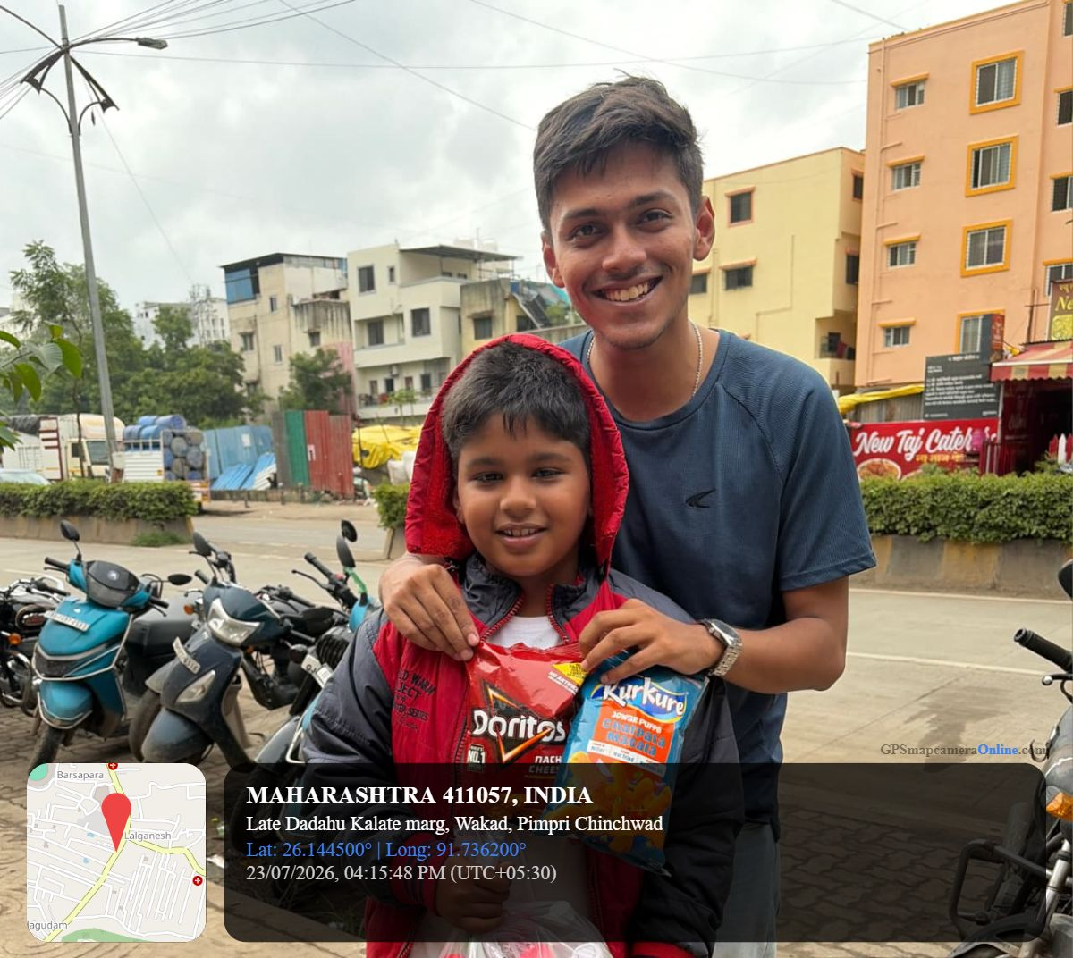
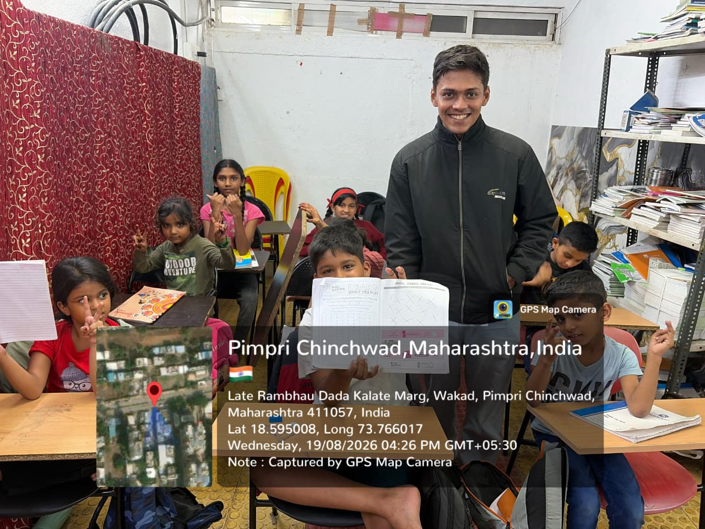
A FEW GLIMPSES
MOMENTS FROM MY SESSIONS
Teaching, encouraging and celebrating small wins, one session at a time.
08

Slide 9
THANK YOU
A Ray of Hope Charitable Trust
Individual contribution, shared mission.

